Slide 1







Playing with Tiny bit
Magic hand
Yahboom

Slide 2









Contents
Preparation
Learning goal
Search for blocks
Combine blocks
Experimental phenomena
Yahboom

Slide 3

Preparation
1.The position of the Ultrasonic module in the robot car
2.Learn about the principle of Ultrasonic module
Ultrasonic ranging principle:
The ultrasonic wave has two ultrasonic probes, which are used for transmitting and receiving ultrasonic waves, respectively, and the measurement range is about 3-450 cm. First, input a 15us high level signal to the SCL (TRIG) pin to start the ranging function of module.
After the ranging function is started, the module will automatically send out 8 40 kHz ultrasonic pulses and automatically detect whether there is a signal return. This step is automatically done internally by the module. When the echo signal is detected, the echo terminal SDA (ECHO) pin will output a high level.
The high level duration is the time from the transmission to the return of the ultrasonic wave. We can calculate the current distance by the high level duration.
Formula: Distance = High Time * Sound Speed (340M/S)/2.
Yahboom

Slide 4
Preparation
Programming method:
Mode 1 online programming: First, we need to connect the micro:bit to the computer by USB cable. The computer will pop up a USB flash drive and click on the URL in the USB flash drive: http://microbit.org/ to enter the programming interface. Add the Yahboom package: https://github.com/YahboomTechnology/Tiny-bitLib to program.
Mode 2 offline programming: We need to open the offline programming software. After the installation is complete, enter the programming interface, click【New Project】, add Yahboom package: https://github.com/YahboomTechnology/Tiny-bitLib, you can program.
Yahboom

Slide 5
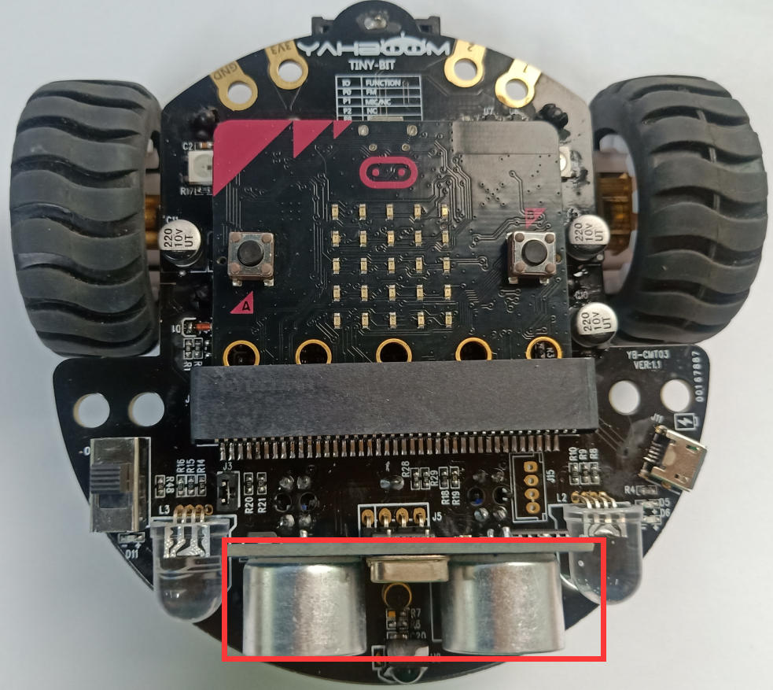
Preparation
In the picture shown below, the ultrasonic module with red wire frame.
Yahboom

Slide 6
Learning goal
1.Learn how to use ultrasonic return distance graphically program building blocks and RGB Searching light graphically program building blocks
2.In this lesson, we will realize that within a certain distance, Tiny-bit can follow the object, and within a certain distance, Tiny-bit can retreat away from the object.
Yahboom

Slide 7

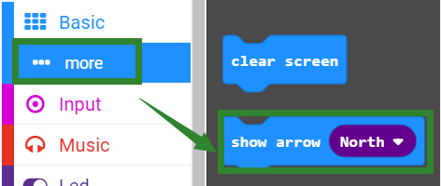
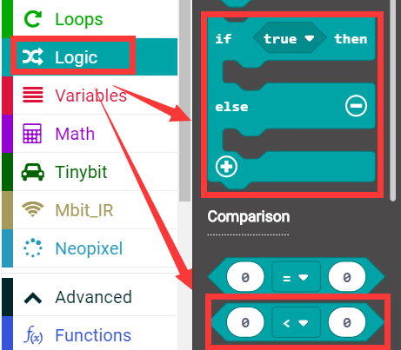
Search for block
The following is the location of the building blocks required for this programming.
Yahboom

Slide 8
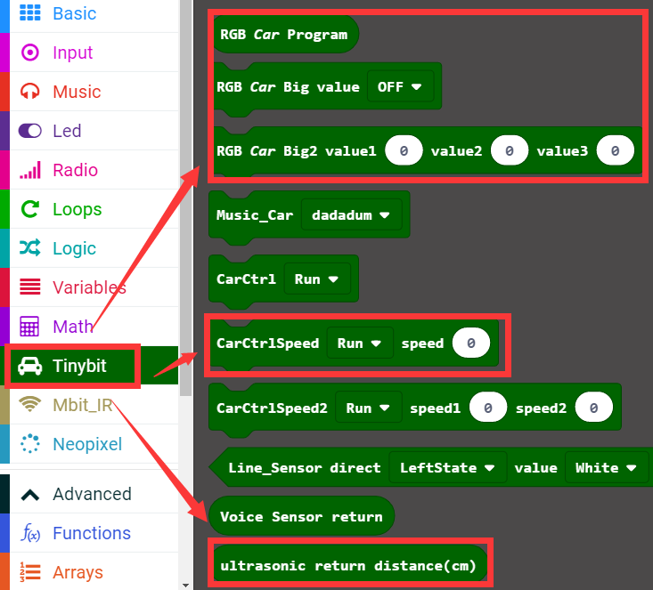
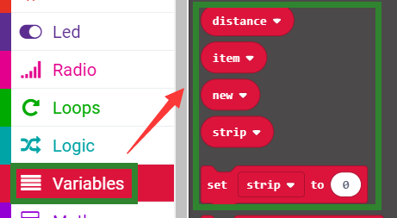
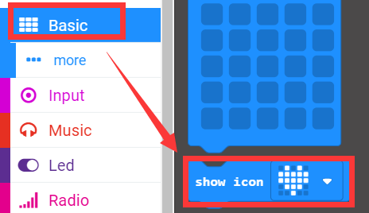
Search for block
Yahboom

Slide 9
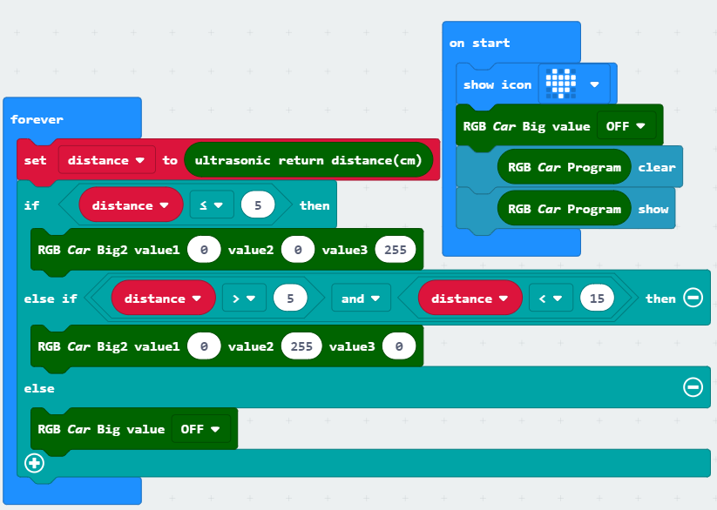
Combine block
The summary program is shown below:
Yahboom

Slide 10
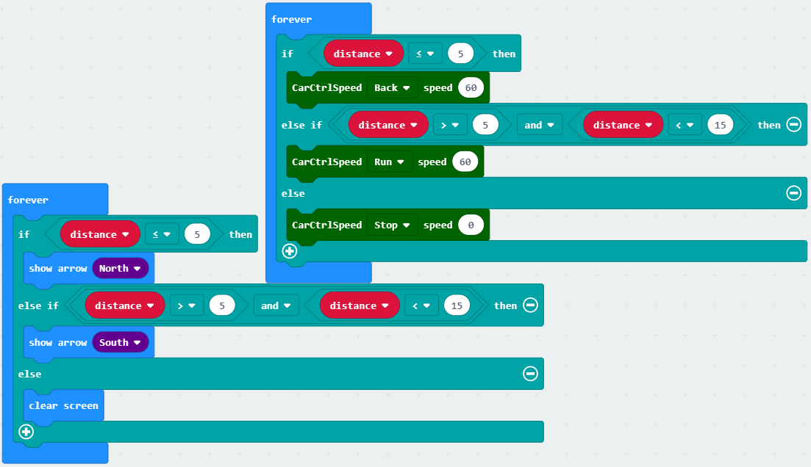
Combine block
Note: The speed and time parameters in the program can be adjusted according to the actual situation.
Yahboom

Slide 11
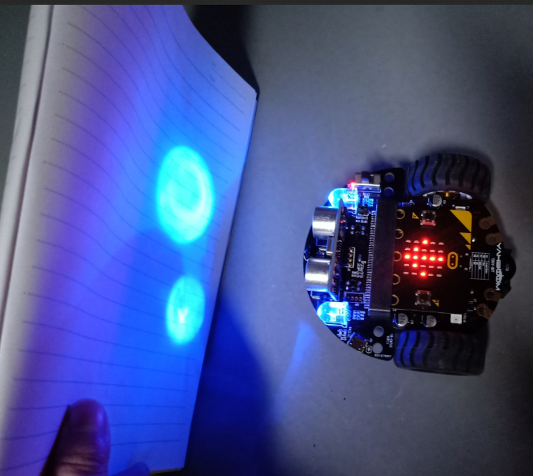
Experimental phenomena
After the program is downloaded, open the power of the robot car. When the distance of the object in front is less than 5 cm, the Tiny-bit will back, the micro:bit dot matrix screen will display the backward arrow, and the RGB searching light will become blue; when the distance of the object in front is 5 cm to 15 cm , the Tiny-bit will follow the object, the micro:bit dot matrix will display the forward arrow, and the RGB searching light will become green.
Yahboom

Slide 12
Inspire Creativity Embrace Innovation
Thank you!!!

